Slide 1
The Teaching Process
Telling is not Teaching
https://docs.google.com/document/d/1gMZ37huuee5S7FhCWDLgdrMkM257mEWpR3hgULXjty8/edit?usp=sharing

Slide 2
Marching/Visual
Teaching Session
Color Guard with Jalen
Luke’s Visual Packet
“M” Teaches Mark Time
Split into groups of 4-6 for Practice Teaching
https://drive.google.com/file/d/1RHlU0IXtWUbkwvUkJb5A77nuUCIysyuG/view?ts=628d1816
https://docs.google.com/document/d/1kvQQW62OaNZYqrW3WQWVl8txsctrqVtuINc0KJ3ZCNI/edit?usp=sharing

Slide 3
Music Teaching Session
Color Guard with Jalen
Chairs, Stands, Ed Sueta Books, #’s of exercises, Music Teaching Strategies, Instruments including percussion.
https://docs.google.com/document/d/1OykmzkQkFgZ2g80Gb_NfztGy1pJD5X8ZrUnFunoroRo/edit?usp=sharing

Slide 4
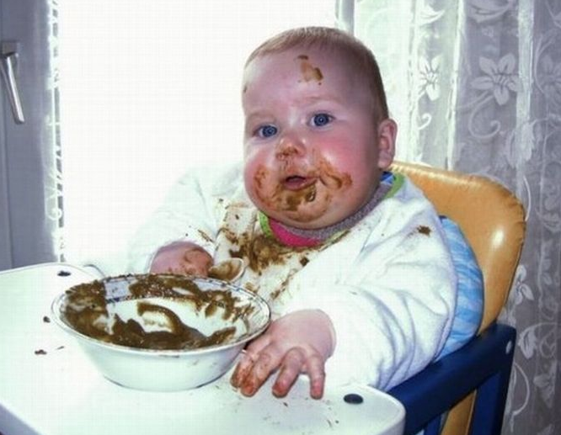
LUNCH!

